Slide 1







Digital Portfolio
STUDENT NAME: S.PANDIMEENA
REGISTER NO AND NMID: 49AAD1860BF97F9A3F7446FD0F0557D9
DEPARTMENT:BACHELOR OF COMPUTER APPLICATION
COLLEGE:RATANKANWAR BHAWARLAL GOTHI JAIN COLLEGE
FOR WOMEN

Slide 2

PROJECT TITLE
My Digital Portfolio Showcasing My Journey To Crafting My
Carrer Path.

Slide 3
AGENDA
1.Problem Statement
2.Project Overview
3.End Users
4. Tools and Technologies
5.Portfolio design and Layout
6. Features and Functionality
7.Results and Screenshots
8.Conclusion
9.Github Link

Slide 4
PROBLEM STATEMENT
Traditional resumes are static and lack interactivity.
Employers need an engaging way to explore candidate profiles.
Digital portfolios present skills, projects, and ambitions effectively.

Slide 5
Project Overview
A personal digital portfolio website.
Built using HTML, CSS, and JavaScript.
Showcases academic background, career goals, and skills.
Provides a professional online presence.

Slide 6
End User
Students – to display their achievements.
Recruiters/Employers – to evaluate skills.
Educators – to guide students on career paths
Peers & Networking. Groups – to collaborate.

Slide 7
TOOLS AND TECHNOLOGIES
HTML5 – Structure of the portfolio.
CSS3 – Styling and design.
JavaScript–Interactivity and responsiveness.
GitHub – Hosting & version control.

Slide 8
PORTFOLIO DESIGN AND LAYOUT
Homepage – Introduction and career goal.
About Me – Academic journey & background.
Skills Section – Technical and soft skills.
Projects Section – Mini & major work.
Contact Section – Email, LinkedIn, GitHub link.

Slide 9
FEATURES AND FUNCTIONALITY
Responsive design for mobile & desktop.
Navigation bar for easy access.
Interactive buttons & animations.
Downloadable resume option.
Direct link to GitHub projects.

Slide 10
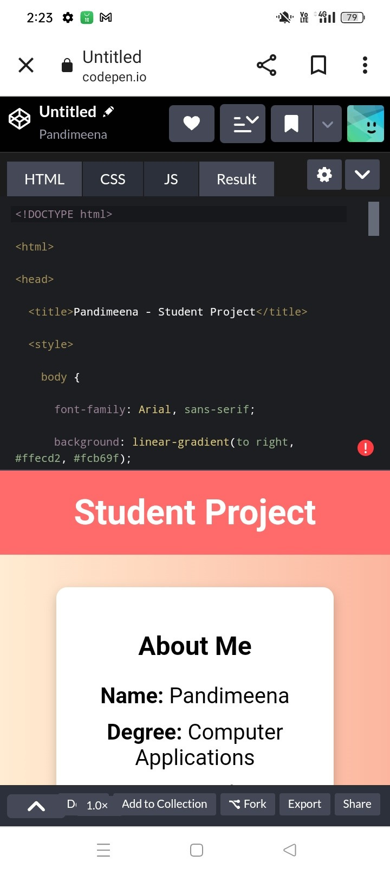
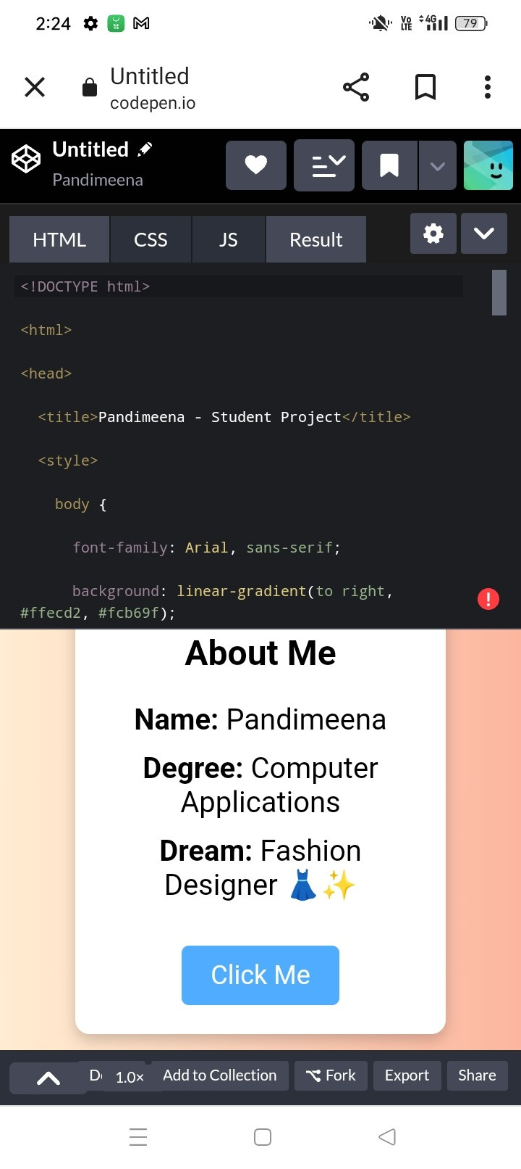
RESULTS AND SCREENSHOTS

Slide 11
CONCLUSION
Digital portfolios are modern alternatives to resumes.
Provide a strong online identity for students.
Help employers quickly evaluate candidates.
Can be continuously updated with new skills/projects.

Slide 12
GITHUB LINK
https://github.com/pandimeena20072005-design/Pandimeena.git

Slide 13
THANK YOU

